Slide 1



Learn Something Every Day
CONFIDENTIAL & PROPRIETARY 2022 – Adverk Technologies

Slide 2
Basic of Statistics
CONFIDENTIAL & PROPRIETARY 2022 – Adverk Technologies

Slide 3

Statistics
CONFIDENTIAL & PROPRIETARY 2022 – Adverk Technologies

Slide 4
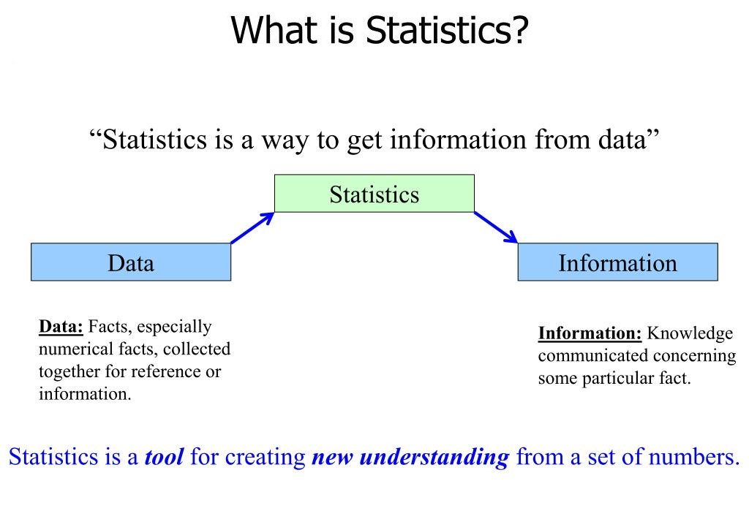
CONFIDENTIAL & PROPRIETARY 2022 – Adverk Technologies

Slide 5



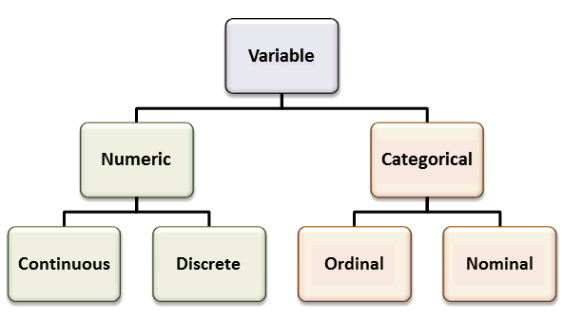
Basics of Statistics
Population
Samples
Variables
Statistical Model
CONFIDENTIAL & PROPRIETARY 2022 – Adverk Technologies

Slide 6
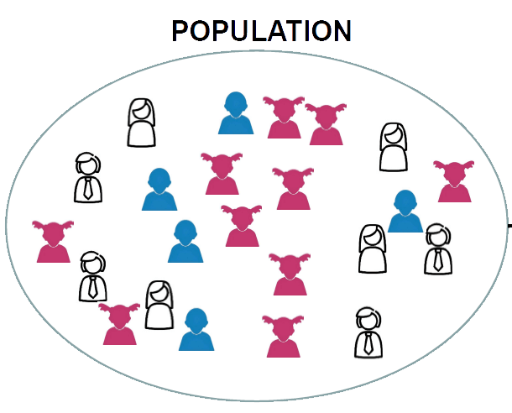
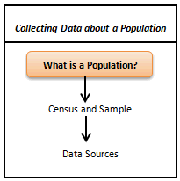
Population
A population is any complete group with at least one characteristic in common. Populations are not just people. Populations may consist of, but are not limited to, people, animals, businesses, buildings, motor vehicles, farms, objects or events.
Population contains all the data points from a set of data. It is a group from where we collect the data.
CONFIDENTIAL & PROPRIETARY 2022 – Adverk Technologies

Slide 7
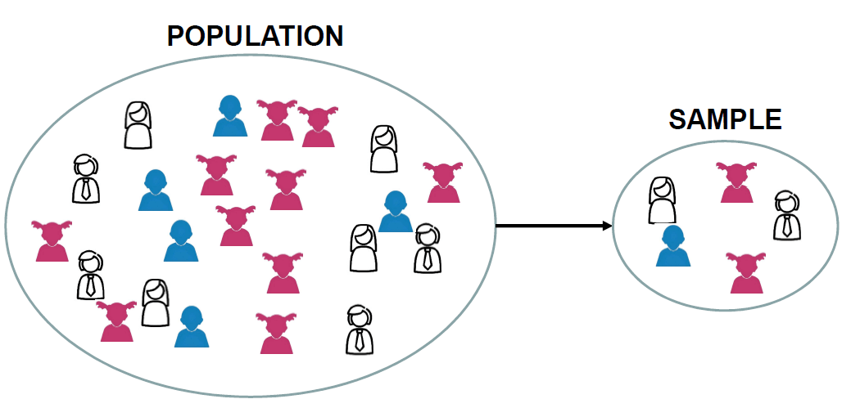
Sample
A sample consists of some observations selected from the population. The sample from the population should be selected such that it has all the characteristics that a population has. Population’s measurable characteristics such as mean, standard deviation etc. are called as parameters while Sample’s measurable characteristic is known as a statistic.
Cluster Sampling | Random Sampling
Stratified Sampling | Systematical Sampling
CONFIDENTIAL & PROPRIETARY 2022 – Adverk Technologies

Slide 8
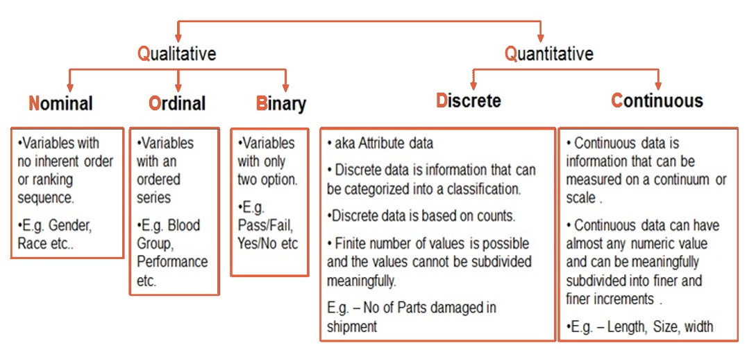
Variables in statistics
CONFIDENTIAL & PROPRIETARY 2022 – Adverk Technologies

Slide 9
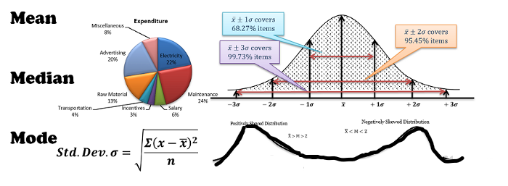
Statistical Model
Statistical modelling is a method of mathematically approximating the world. Statistical models contain variables that can be used to explain relationships between other variables. We use hypothesis testing, confidence intervals etc to make inferences and validate our hypothesis.
A statistical model will have sampling, probability spaces, assumptions and diagnostics etc, to make inferences.
We use statistical models to find insights given a particular set of data. We can conduct modelling on a relatively small set of data just to try and understand the underlying nature of the data.
CONFIDENTIAL & PROPRIETARY 2022 – Adverk Technologies

Slide 10
Different Types of Analysis
CONFIDENTIAL & PROPRIETARY 2022 – Adverk Technologies

Slide 11


Different Types of Analysis
Qualitative Analysis
Quantitative Analysis
CONFIDENTIAL & PROPRIETARY 2022 – Adverk Technologies

Slide 12
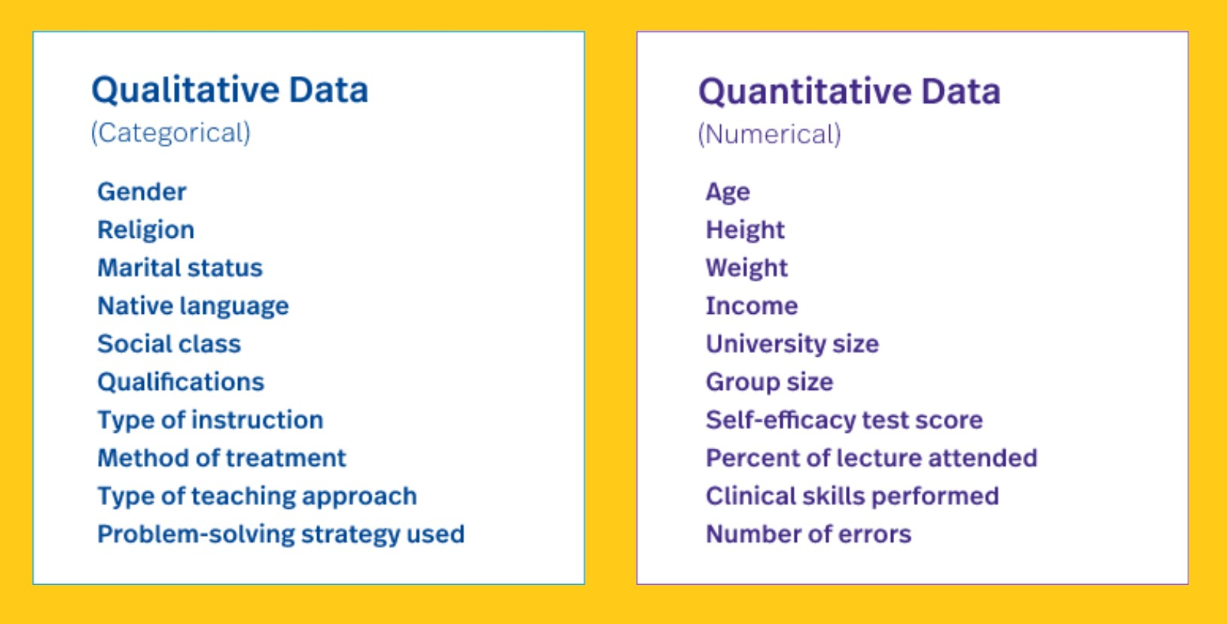
Different Types of Analysis
CONFIDENTIAL & PROPRIETARY 2022 – Adverk Technologies

Slide 13
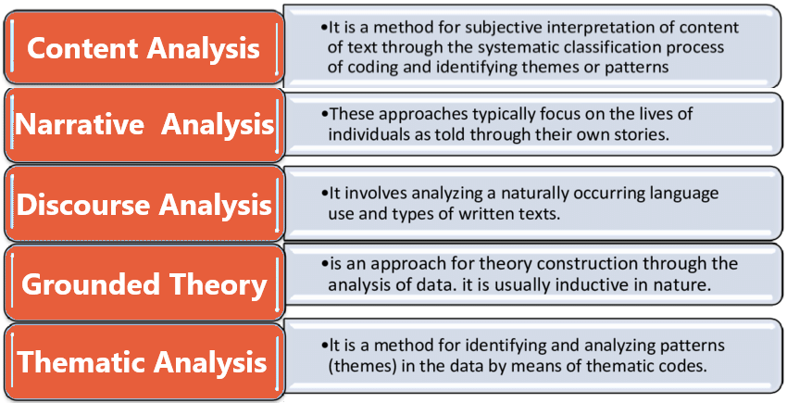
Qualitative Analysis
CONFIDENTIAL & PROPRIETARY 2022 – Adverk Technologies

Slide 14
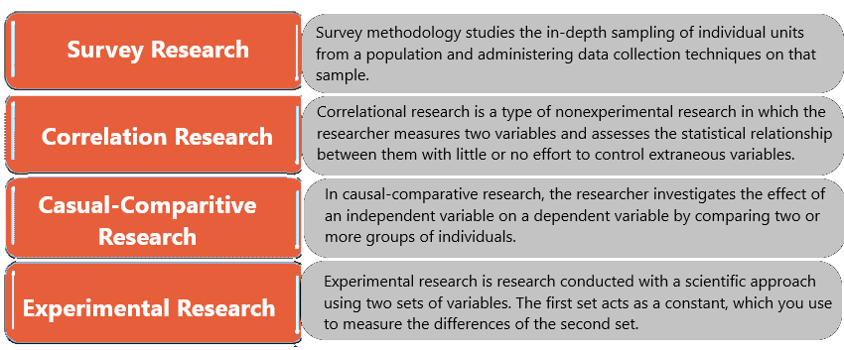
Quantitative Analysis
CONFIDENTIAL & PROPRIETARY 2022 – Adverk Technologies

Slide 15
Types of
in
Statistic Analysis
CONFIDENTIAL & PROPRIETARY 2022 – Adverk Technologies

Slide 16
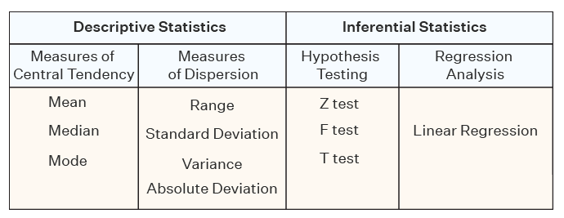
Statistic Analysis
CONFIDENTIAL & PROPRIETARY 2022 – Adverk Technologies

Slide 17
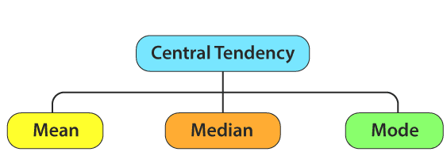
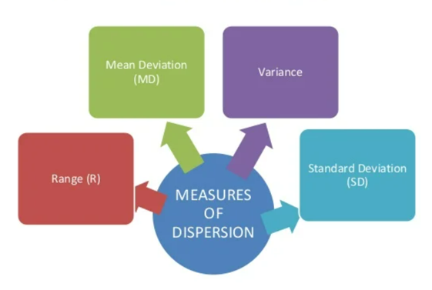
Measures of central tendency
and
Dispersion
CONFIDENTIAL & PROPRIETARY 2022 – Adverk Technologies

Slide 18
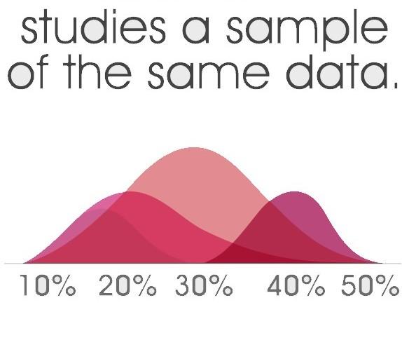
Inferential statistics
CONFIDENTIAL & PROPRIETARY 2022 – Adverk Technologies

Slide 19
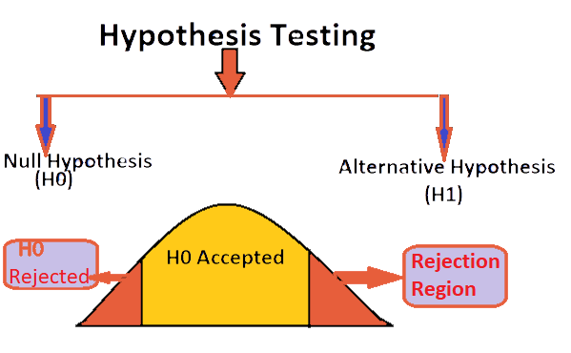
CONFIDENTIAL & PROPRIETARY 2022 – Adverk Technologies

Slide 20
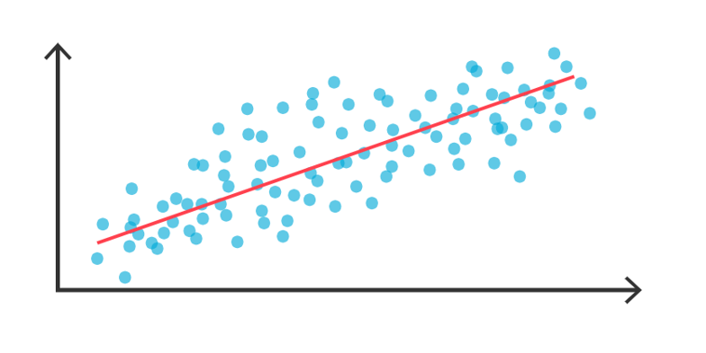
Regression Analysis
CONFIDENTIAL & PROPRIETARY 2022 – Adverk Technologies

Slide 21
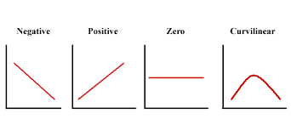
Relationship between variables
CONFIDENTIAL & PROPRIETARY 2022 – Adverk Technologies

Slide 22
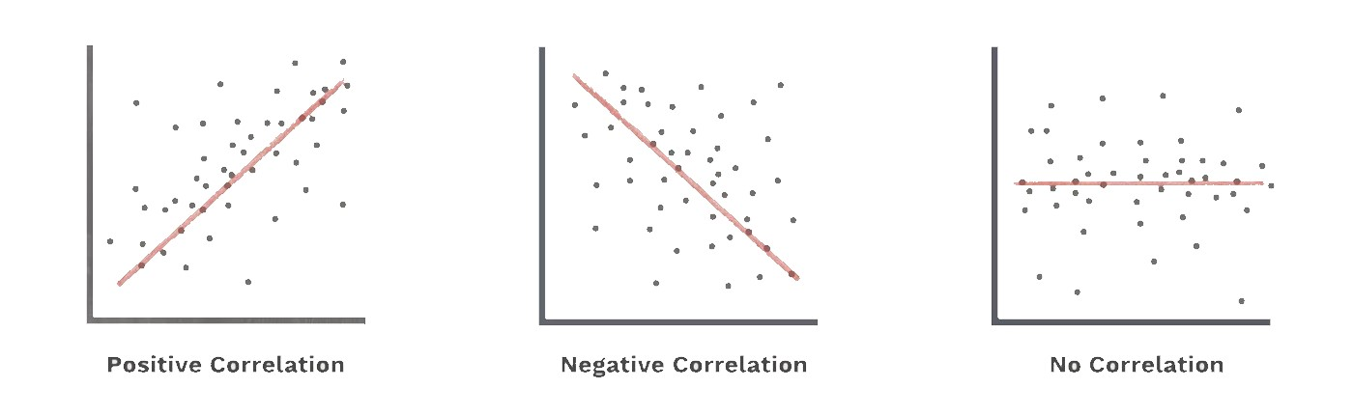
Relationship between variables
CONFIDENTIAL & PROPRIETARY 2022 – Adverk Technologies

Slide 23
Probability Distribution
CONFIDENTIAL & PROPRIETARY 2022 – Adverk Technologies

Slide 24
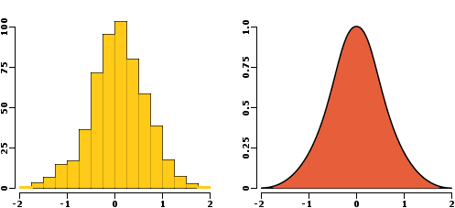
Probability Distribution
Distribution function is a mathematical expression that describes the probability that a system will take on a specific value or set of values.
CONFIDENTIAL & PROPRIETARY 2022 – Adverk Technologies

Slide 25
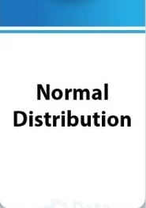


Probability Distribution
CONFIDENTIAL & PROPRIETARY 2022 – Adverk Technologies

Slide 26
Probability Distribution
Normal Distribution:
The normal distribution is a symmetric probability distribution centered on the mean, indicating that data around the mean occur more frequently than data far from it. the normal distribution is also called Gaussian distribution. The normal distribution curve resembles a bell curve.
CONFIDENTIAL & PROPRIETARY 2022 – Adverk Technologies

Slide 27
Probability Distribution
Binomial Distribution
Under a given set of factors or assumptions, the binomial distribution expresses the likelihood that a variable will take one of two outcomes or independent values.
CONFIDENTIAL & PROPRIETARY 2022 – Adverk Technologies

Slide 28
Probability Distribution
Poisson Distribution:
A Poisson distribution is a kind of probability distribution used in statistics to illustrate how many times an event is expected to happen over a certain amount of time. It’s also called count distribution.
CONFIDENTIAL & PROPRIETARY 2022 – Adverk Technologies

Slide 29
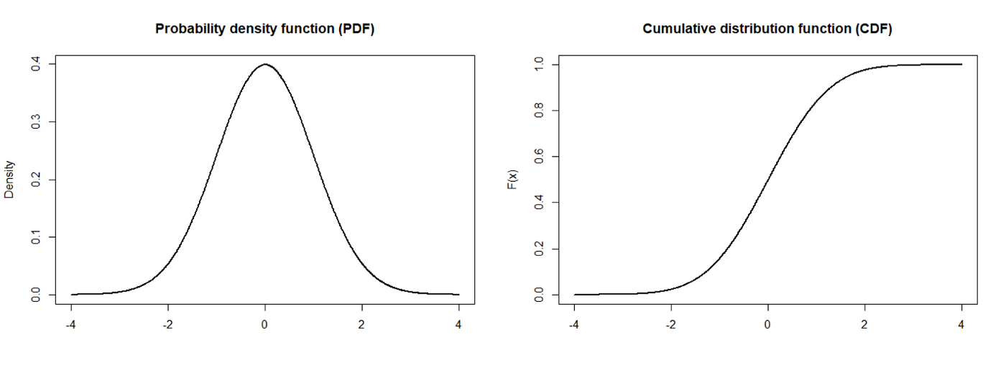
PDF & CDF
Probability density Function
&
Cumulative Distribution Function
The cumulative distribution function is applicable for describing the distribution of random variables either it is continuous or discrete
PDF is a statistical term that describes the probability distribution of the continues random variable
CONFIDENTIAL & PROPRIETARY 2022 – Adverk Technologies

Slide 30
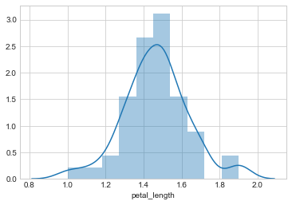
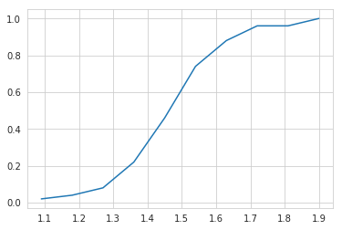
PDF & CDF
PDF On Iris
CDF on Iris
PDF for [‘species’]== ‘setosa’ on petal length
CDf of iris_setosa using petal length
CONFIDENTIAL & PROPRIETARY 2022 – Adverk Technologies

Slide 31
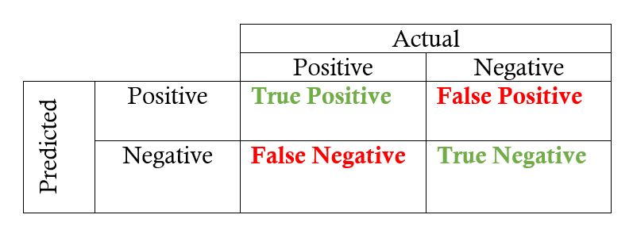
Accuracy
CONFIDENTIAL & PROPRIETARY 2022 – Adverk Technologies

Slide 32
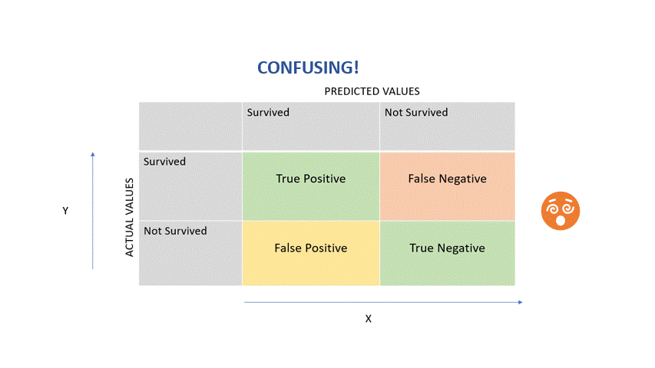
CONFIDENTIAL & PROPRIETARY 2022 – Adverk Technologies

Slide 33
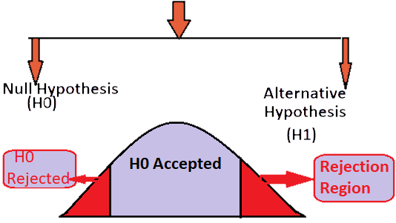
Hypothesis Testing
CONFIDENTIAL & PROPRIETARY 2022 – Adverk Technologies

Slide 34
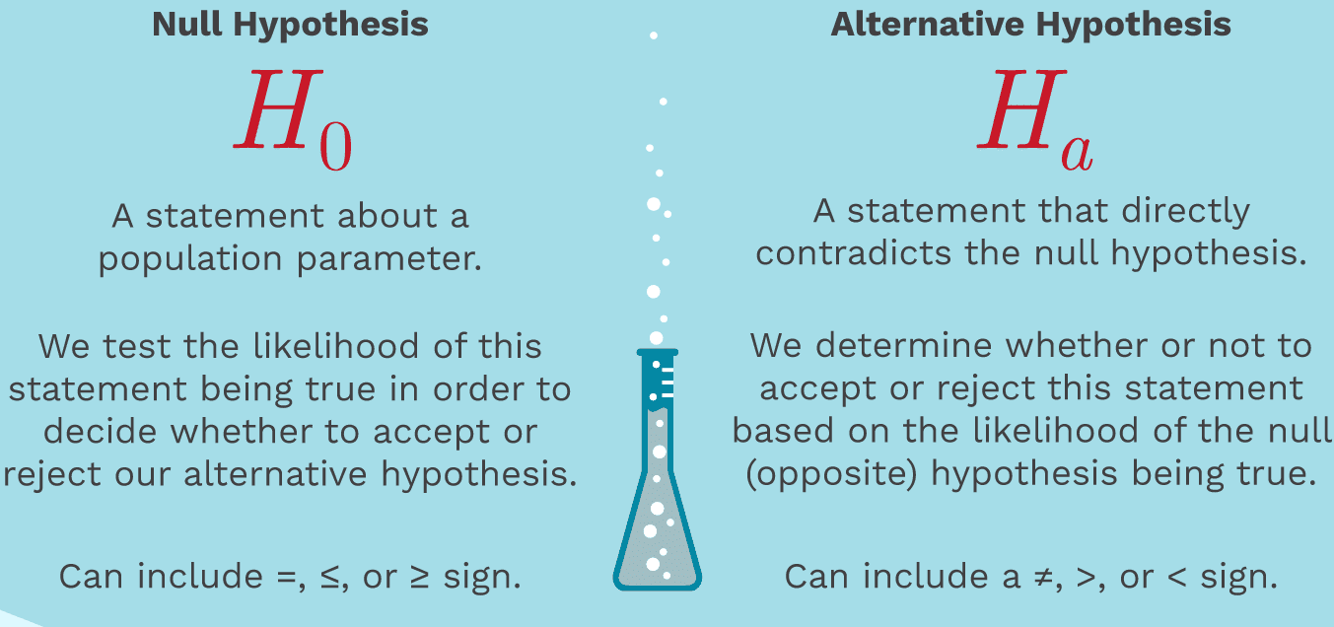
Hypothesis Testing
CONFIDENTIAL & PROPRIETARY 2022 – Adverk Technologies

Slide 35
Hypothesis Testing
The two types of hypothesis testing are null hypothesis and alternate hypothesis.
Null hypothesis is the initial assumption about an event (also referred to as the ground truth).
Alternate hypothesis is an assumption that counters the initial assumption.
CONFIDENTIAL & PROPRIETARY 2022 – Adverk Technologies

Slide 36
Example of Hypothesis Testing
With T test
A t-test is a statistical test that is used to compare the means of two groups. It is often used in hypothesis testing to determine whether a process or treatment actually has an effect on the population of interest, or whether two groups are different from one another.
The null hypothesis (H₀) is that the true difference between these group means is zero.
The alternate hypothesis (H_{a}) is that the true difference is different from zero.
A p-value is a statistical measurement used to validate a hypothesis against observed data.
A p-value measures the probability of obtaining the observed results, assuming that the null hypothesis is true.
The lower the p-value, the greater the statistical significance of the observed difference.
A p-value of 0.05 or lower is generally considered statistically significant.
P-value can serve as an alternative to or in addition to preselected confidence levels for hypothesis testing.
CONFIDENTIAL & PROPRIETARY 2022 – Adverk Technologies

Slide 37
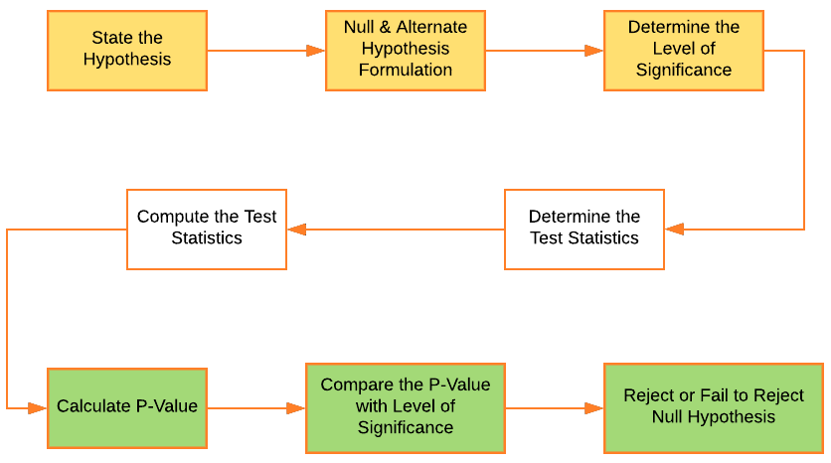
Hypothesis Testing Workflow
CONFIDENTIAL & PROPRIETARY 2022 – Adverk Technologies

Slide 38
THANK YOU!
CONFIDENTIAL & PROPRIETARY 2022 – Adverk Technologies

